Slide 1

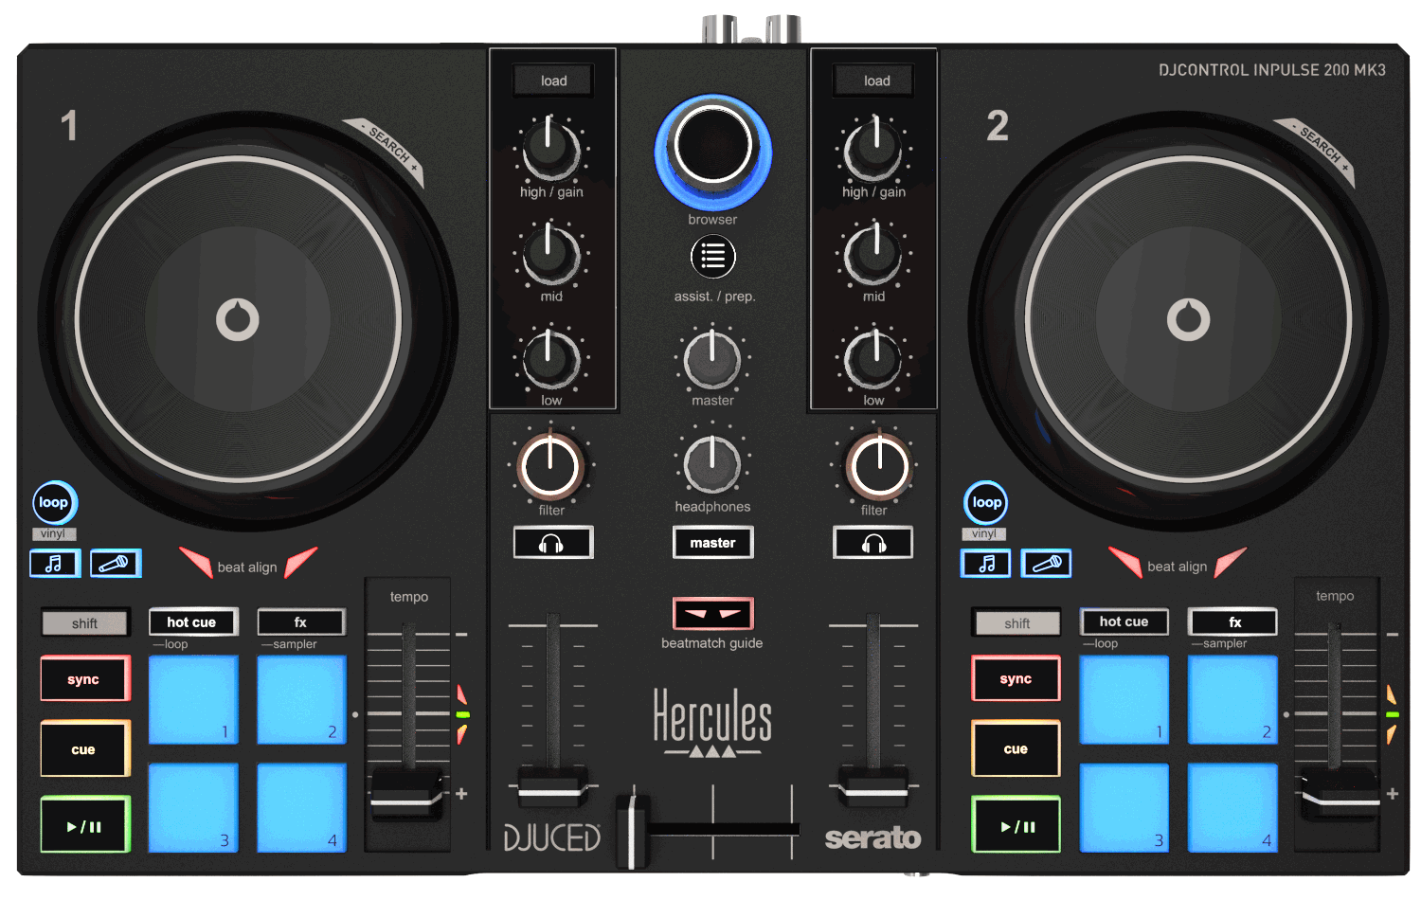



The ideal controller to start DJing
Connect it to the USB-C port on your PC/Mac computer
Mix with Serato DJ Lite and DJUCED®
Learn how to beatmatch manually by looking at the built-in dynamic light guides
Separate the sound into stems (vocals/instrumentals) to remix tracks
Mix and scratch, have fun and improve your skills!
Beatport, Beatsource, TIDAL and SoundCloud streaming services
Broadcast your performances using the included virtual sound card
KEY FEATURES
mixing and performance DJ software from Hercules
Assistant: suggests the best upcoming tracks, so that you’ll always stay inspired
Stems: separate the vocal and instrumental parts for a different kind of mixing
Precise audio engine and full DJing features
with features for learning to mix and scratch
Use stems to separate a cappella and instrumental parts, and create mashups
Includes a free 2-week trial of Serato DJ Pro
Serato DJ Lite is based on the same technology as Serato DJ Pro
Compatible with streaming services: mix millions of tracks from Beatport LINK, Beatsource LINK, SoundCloud Go+ and TIDAL (+ Apple Music in Serato DJ).
Hercules Official Music: royalty-free tracks that you can mix with on any media.
Virtual sound card: the virtual sound card establishes a virtual link between the DJ controller’s master output and the broadcasting app’s audio input.
THE GOLD STANDARD FOR 2-DECK MIXING
Built-in audio: Master (speakers) and monitoring (headphones) outputs
Decks: 2 Play, Cue, Sync, Shift sections / 2 jog wheels / 2 x 4 pads with 4 modes (Hot Cue, FX, Loop, Sampler) / 2 tempo faders / 2 x 2 stems buttons
Mixing: 1 crossfader , 2 mixers (3-band EQ, Filter, Volume), monitoring controls, master volume
STEMS
Split up tracks into instrumental and vocal stems
Create mashups by playing the vocal from track A over the instrumental from track B
Create transitions by mixing the instrumental of the next track over the vocal of the one that’s playing
BEATMATCH GUIDE
Built-in light guides: no need to look at a screen
Tempo guide: indicates where to move the tempo fader
Beat Align guide: indicates which direction to turn the jog wheel

Slide 2
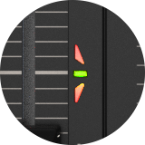
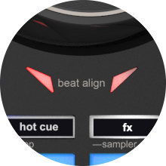
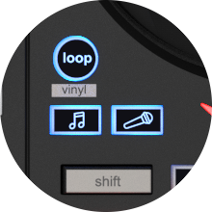
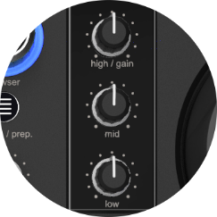
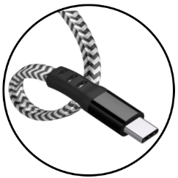
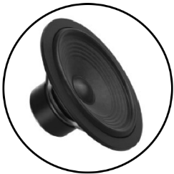




 | TECHNICAL SPECIFICATIONS
DIMENSIONS/ WEIGHT | Size: 12.6 x 7.7 x 1.9“ / 320 x 195 x 49 mm Weight: 2.0 lb / 0.9 kg
 | Jog wheel diameter: 3.5” / 90 mm
CONNECTIONS | Master output for speakers: 2 RCA jacks
 | Headphones/monitoring output: 1/8” / 3.5 mm stereo mini-jack
 | Male USB-C connector (to connect to the computer)
CONTROLS | Mixing controls 1 filter knob, 3 EQ knobs, 1 volume fader per deck Crossfader, master volume knob, headphones volume knob
 | Controls per deck Jog wheel: touch detection in vinyl mode 4 pads × 4 modes (Hot Cue, FX, Loop, Sampler) Stems section (instruments/vocals), tempo fader
 | Browser controls Browser knob + 2 Load buttons + Assistant button
BEATMATCH GUIDE | Tempo: light guide alongside each tempo fader
 | Beat Align: light guide below each jog wheel
ASSISTANT | Assistant: DJUCED® suggests tracks from your library that match the one playing in terms of BPM, key and energy
DJ ACADEMY | Video tutorials to help you learn the basics of DJing, master the software and hone your skills https://www.hercules.com/dj-academy/
OFFICIAL MUSIC | Dozens of new royalty-free tracks that you can use to mix on all media https://www.hercules.com/music/
SOFTWARE | DJUCED®
 | Serato DJ Lite
VIRTUAL SOUND CARD | This virtual sound card establishes an audio input that broadcasts the master output. Connecting it virtually to broadcasting software, such as OBS, lets you stream the DJ performance online in real time.
SYSTEM REQUIREMENTS | https://serato.com/dj/lite/downloads?systemrequirements#system-requirements
 | https://www.djuced.com/downloaddjuced/
Beatmatch guides
Tempo
Beat align
Stems buttons
3-band EQ
USB-C connection
Virtual sound card
BOX CONTENTS
DJControl Inpulse 200 MK3
Braided USB cable attached to the controller
DJUCED® and Serato DJ Lite licenses
Instruction manual
Warranty information leaflet
PACKAGING INFORMATION
Color box dimensions: 14.3 x 9.2 x 3.1” / 363 x 233 x 80 mm (W x H x D)
Master carton dimensions: 15.6 x 10.4 x 3.7” / 395 x 263 x 95 mm (W x H x D)
Units per master carton: 1
Master carton weight: 3.28 lb / 1.49 kg
Units per pallet (31.5 x 47.2” / 80 x 120 cm): 144
LOGISTICS INFORMATION
Product name | DJControl Inpulse 200 MK3
Product code | 4781119
International barcode (excluding U.S. and Canada) | 3 36293 474781 7
U.S. and Canada barcode | 6 6329642658 1
Suggested retail price | $119.99 / €109.99

