Slide 1
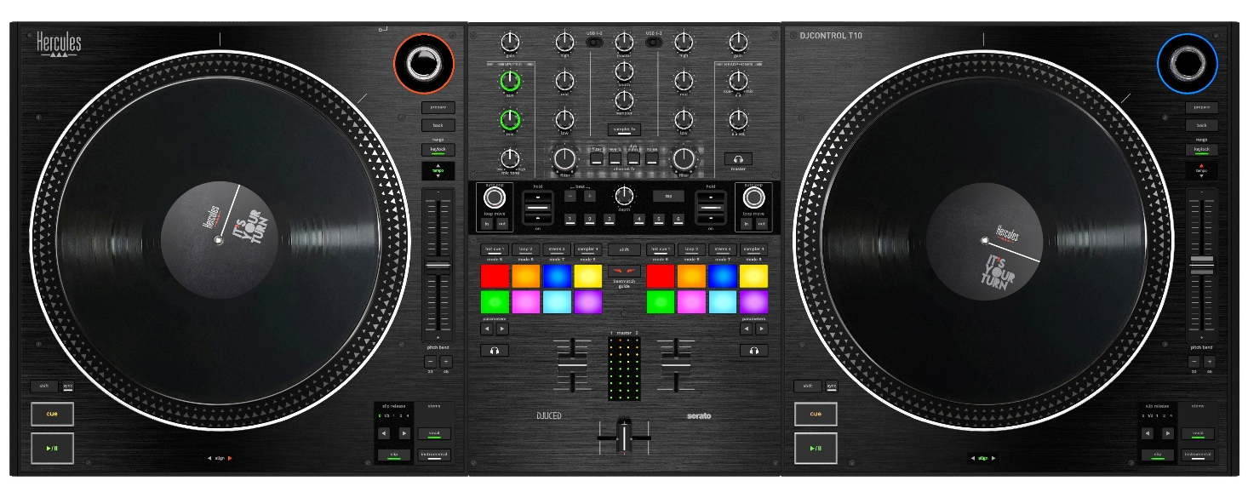

Motorized DJ performance controller with 10” vinyl discs
Experience the same movements as on vinyl turntables, using real 10” discs.
Mixer area designed for battles, with optimized ergonomics.
InduXfader: the contactless Hercules crossfader for smooth sliding and clean cuts.
Easy to transport, so you can play anywhere: weight < 17.6 lb / 8 kg, with retractable feet.
Isolate instruments or vocals using stems, via dedicated buttons.
Serato DJ Pro and DJUCED® PRO included.
KEY FEATURES
Serato DJ Pro — the most highly-renowned DJ software — is the benchmark for hip-hop and urban music performers.
For scratchers already using Serato DJ Pro in DVS, DJControl T10 lets you switch to the controller without changing your software or music library.
Serato DJ Pro is fully customizable, adapting to each DJ’s settings and style.
Pitch’n Time expansion included.
Powerful, intuitive and full-featured, DJUCED® PRO is the most advanced version of the Hercules DJ software, designed to help you put on pro-level performances.
It lets you record your DJ sets (excluding streaming), customize the controller mapping and visually enhance your music with video loops.
Compatible streaming services: Apple Music (via Serato DJ), Beatport, Beatsource, SoundCloud, Spotify (via Serato DJ) and TIDAL.
YOUR WAY, WITH NO COMPROMISES
2 large 10” vinyl discs, plus Dr. Suzuki felt slipmats and Dr. Suzuki slipsheets: an authentic feel, just like on real turntables.
InduXfader contactless crossfader: precise cuts, light touch, adjustable.
Adjustable non-slip feet: choose your preferred height by extending them or leaving them folded in.
Set up in just two minutes: connect the USB cable to your computer, plug in the power supply, connect speakers or headphones, start up the DJ software, and you're ready to mix.
Dual USB-C inputs for switching between DJs and back-to-back sets.
YOUR TECHNIQUE, YOUR SOUND
Show off your DJing skills with the large motorized platters.
Mix quickly with tons of amazing possibilities thanks to large RGB pads in the center.
Instantly start and stop effects using the FX paddles.
TAKE YOUR MUSIC TO THE NEXT LEVEL
Isolate instruments with stems, accessible via dedicated buttons.
Instantly resume your audio from the right spot after scratching, by enabling Slip mode.
Precisely control the effects, FX channels and sampler.

Slide 2
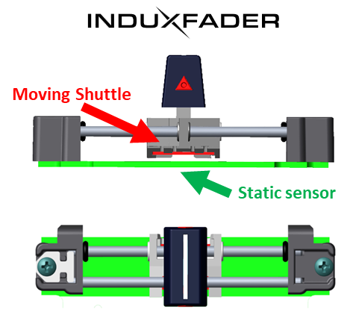
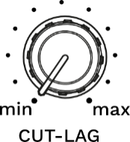
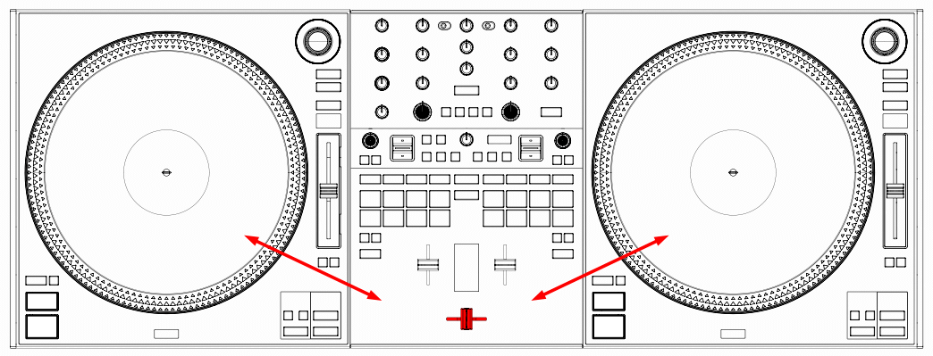
CONTACTLESS
PRECISE CUTS
 | TECHNICAL FEATURES
TECHNOLOGY | InduXfader is the brand-new Hercules contactless crossfader using electromagnetic induction. The crossfader’s shaft is attached to a shuttle guided by two rails. A circuit located beneath the shuttle tracks the shuttle’s movements without any contact, via a proximity sensor.
 | Advantages: Durable: no contact means little wear on the sensor. Stable: the position is detected even if you press down on the crossfader’s shaft. Smooth: without any contact, the crossfader is lighter.
PRECISE CUTS | The “Cut-Lag” button lets you adjust the cut: the minimum setting gives you a super-short cut that’s perfect for scratching.
ADJUSTABLE WEIGHT | As the contactless crossfader has no friction with its sensor, a mechanical feel is added by way of a “FEELING ADJUST: Light–Heavy” thumbwheel accessible on the front panel.
SILENT | A bumper at each end of the rail absorbs impacts from the crossfader, to prevent rattling on both sides.
TWO OTHER SETTINGS CONTROLS | DJControl T10 features two other crossfader settings on the front panel: Curve: a potentiometer that adjusts the fast-slow curve. Reverse: a button to reverse the crossfader.
LOTS OF ROOM FOR THE CROSSFADER
ADJUSTABLE FEEL
SILENT

Slide 3
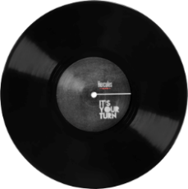
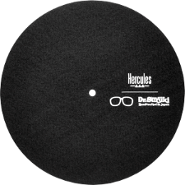
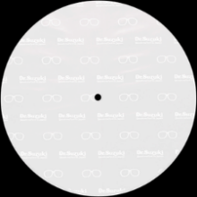
 | TECHNICAL SPECIFICATIONS
DIMENSIONS/ WEIGHT | Dimensions with feet folded in: 37.4 x 13.9 x 3.7” / 95 x 35.3 x 9.5 cm (including height of platters’ central spindle)
 | Dimensions with feet extended: 37.4 x 13.9 x 5.1” / 95 x 35.3 x 13 cm
 | Controller weight: 16.1 lb / 7.3 kg
CONNECTORS | Computer: 2 USB-C ports (for 1 or 2 computers)
 | Power supply: DC socket (18.5 V / 2.6 A)
 | Male USB-C connector (to plug into the computer)
AUDIO OUTPUTS | Master: 2 x balanced XLR (+28 dBu) + 2 x RCA (+7 dBu)
 | Headphones outputs: 1/4“ / 6.35 mm stereo jack + 1/8” / 3.5 mm stereo mini-jack
 | Booth output: 2 x balanced 1/4“ / 6.35 mm jacks
AUDIO INPUTS | Microphone: balanced XLR / 1/4“ / 6.35 mm jack combo Gain from 0 to +60 dB Tone control
 | Auxiliary: 2 x RCA
CONTROLS PER DECK | Motorized jog wheel / Play, Cue, Sync, Shift / Browser (Load, Prepare) / Tempo fader (Range, Pitch Bend -/+) / Stems: Vocal – Instrument / Slip & Slip Release
MIXER AREA CONTROLS | Top zone Per deck: 1 Gain + 3 EQ + 1 Filter + 1 USB selector Master Volume, Booth, Sampler, Aux, Mic, Headphones Mic tone, Cue-to-Mix (headphones) 4 FX channels (filter, rev., dub echo, noise) + FX sampler
 | Middle zone Per deck: Autoloop + Loop In/Out Per deck: FX paddle FX Depth + 6 FX + Tap + Beat -/+
 | Bottom zone 2 x (8 RGB pads + 4 modes) + Shift + 2 x Monitoring + 2 x 2 parameters 2 x volume faders 1 x contactless crossfader
CONTACTLESS CROSSFADER | Front panel settings: weight, curve, reverse and cut off
SERATO DJ PRO | https://serato.com/dj/pro/downloads?systemrequirements
DJUCED® PRO | https://www.djuced.com/downloaddjuced/
10’’ vinyl
+
Slipmat
+
Slipsheet
Dual USB-C inputs
Portable
Contactless crossfader
XLR outputs
BOX CONTENTS
Hercules DJControl T10 controller
Electrical adapter with Europlug and U.S. plug connectors
USB-C cable
2 x 10” vinyl discs + 2 x Dr. Suzuki felt slipmats + 2 x Dr. Suzuki slipsheets
DJUCED® PRO and Serato DJ Pro licenses (+ P’nT DJ)
Installation guide + Warranty card
LOGISTICS INFORMATION
Product name | DJControl T10 EU-US
Product reference | 4781124
International barcode (EAN) | 3362934747862
U.S./Canada barcode (UPC-A) | 663296426758
Suggested retail price | $1,399.99 (USD) / €1,299.99
PACKAGING INFORMATION
Box dimensions: 41.3 x 18.5 x 7.5” / 105 x 47 x 19 cm
Master carton dimensions: 41.7 x 18.9 x 7.9” / 106 x 48 x 20 cm
Weight: TBC

