Slide 1

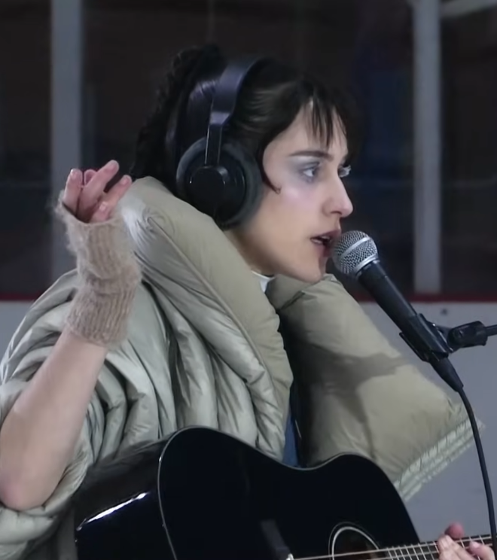
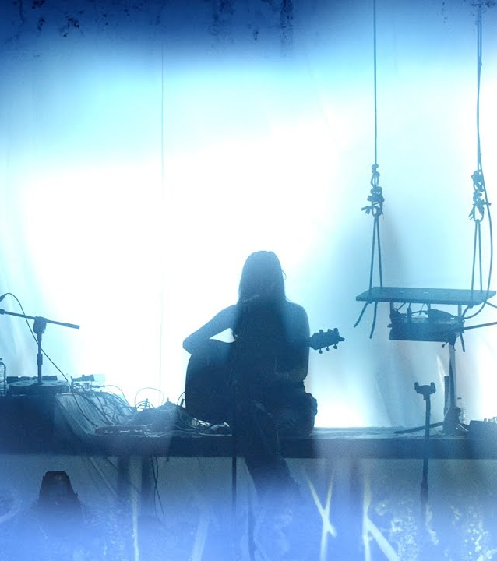
OKLOU
Artist Series
Marketing Plan
01.07.2026

Slide 2
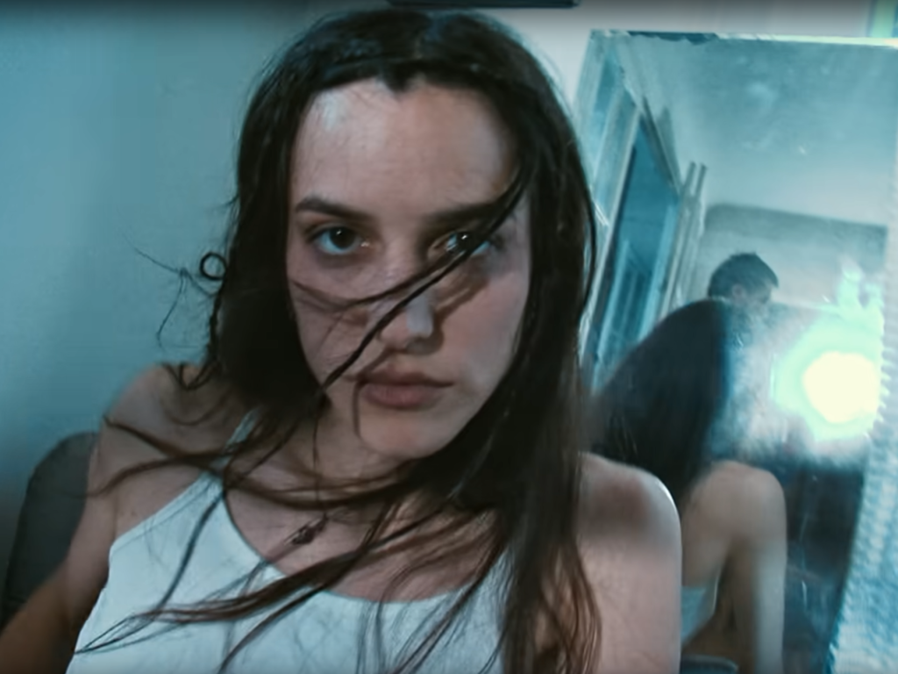

Marketing Plan
Key Narrative
As the second installment in our new series, we’re excited to be partnering with French singer and producer Oklou. Her forward-thinking approach to music - blending electronic pop, hyperpop, and experimental sounds - aligns perfectly with AIAIAI’s audience.
Some key narrative elements of this collab include:
Oklou showcases boundary-pushing creativity in her live performance, merging sound and visuals into immersive art.
She’s demonstrated her ability to create memorable, authentic experiences.
Oklou is respected in the music industry, having collaborated with major artists like PinkPantheress, A.G. Cook, Bladee, FKA Twigs, Flume, and others - she is an artist’s artist.
A partnership with Oklou provides an opportunity to create visually engaging content and connect with an audience that values high-quality audio.
Her strong social media presence expands our reach while maintaining authenticity, making the collaboration feel natural and culturally relevant.
OKLOU x AIAIAI

Slide 3
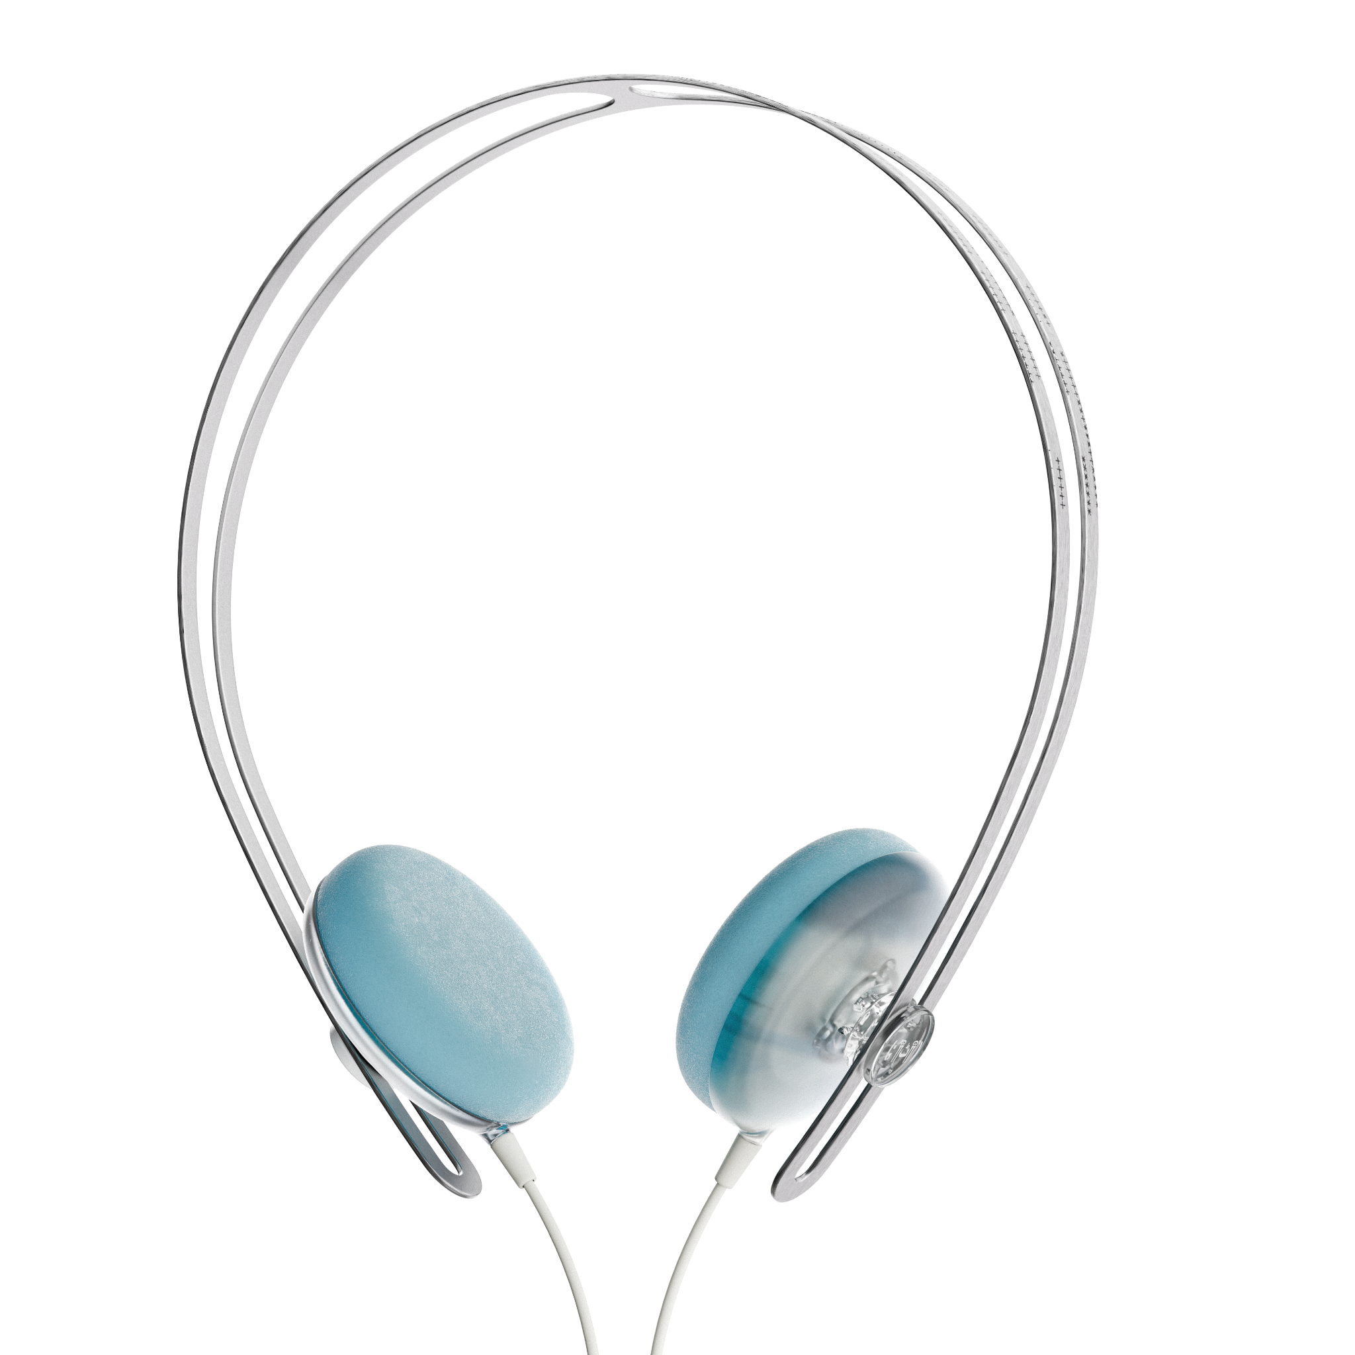
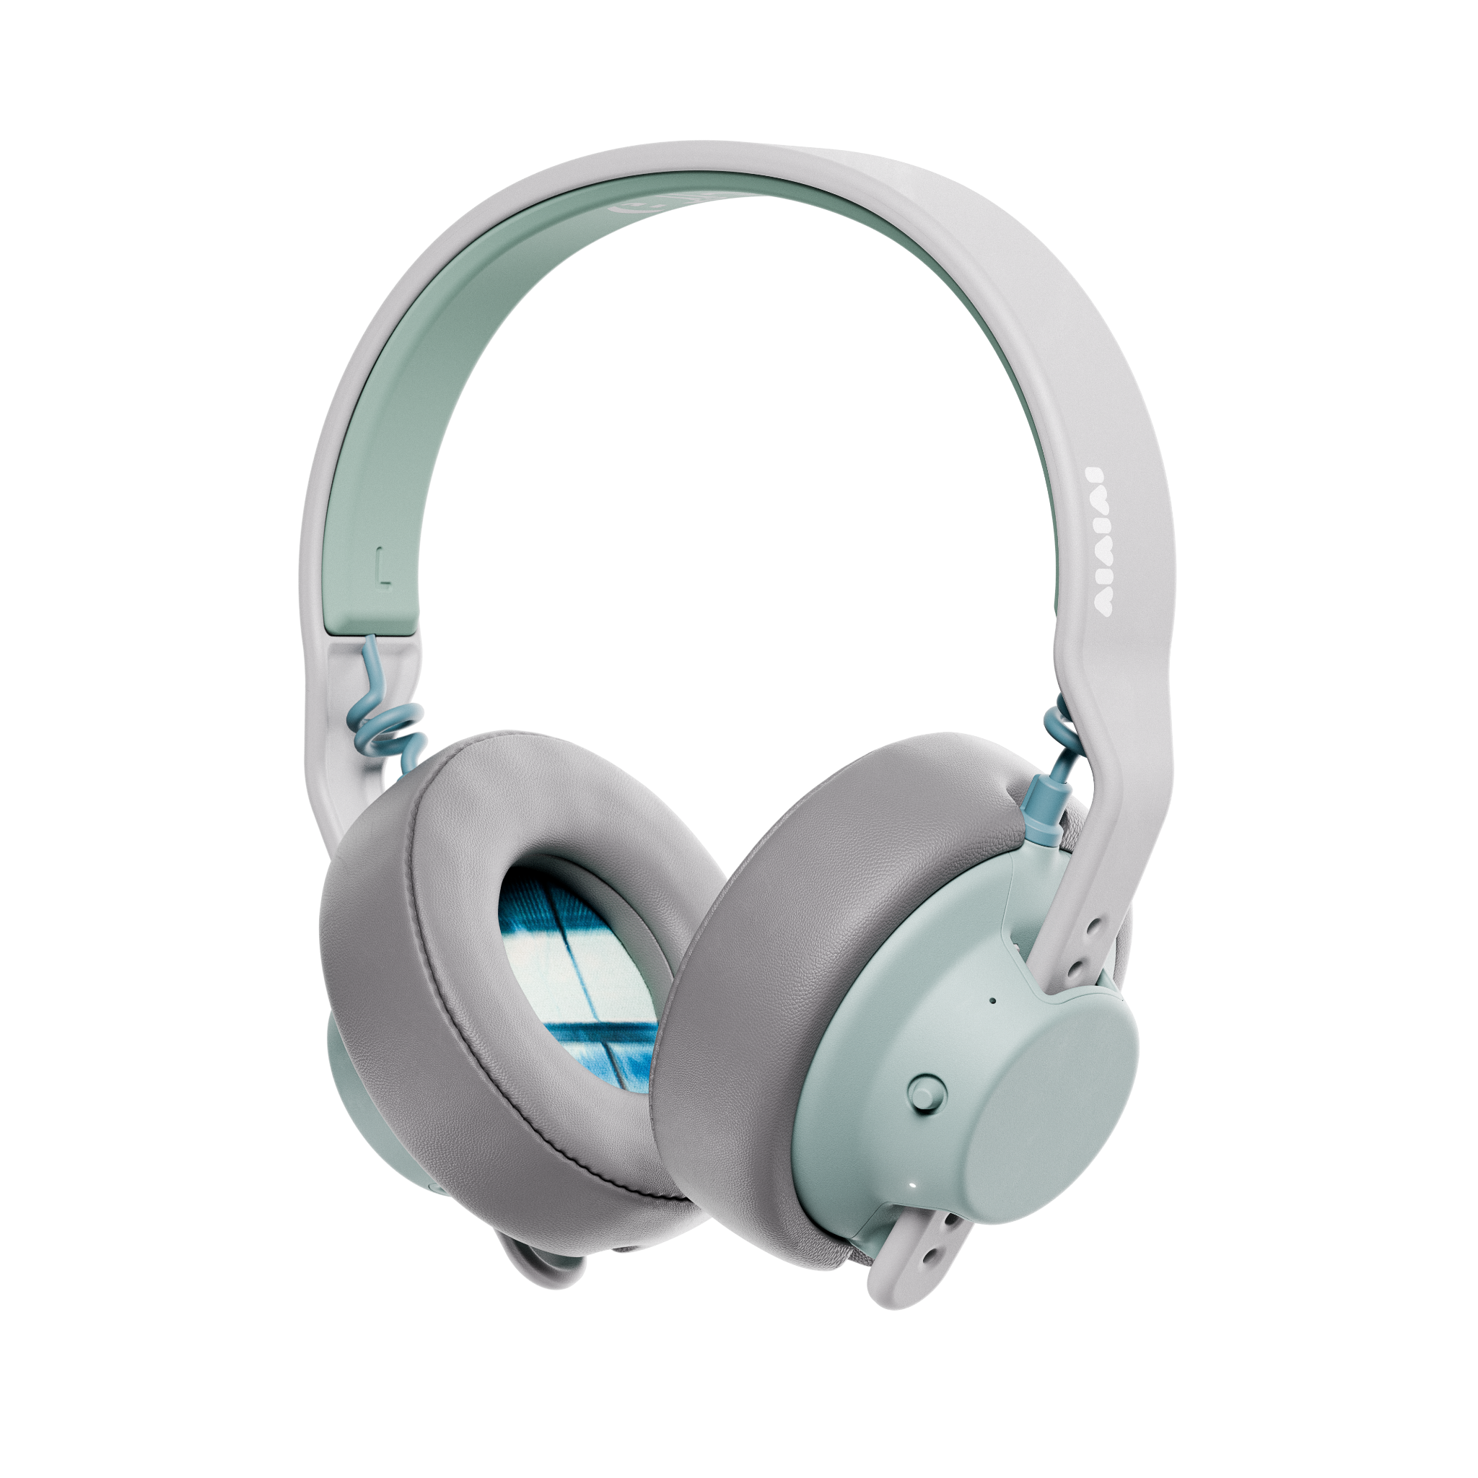
Introduction
Product Offering
55707 | Tracks OKLOU Edition - 3.5mm | 40mm speaker for full-spectrum sound | 5710224557079 | $70
55710 | Tracks OKLOU Edition - USB-C | 40mm speaker for full-spectrum sound | 5710224557109 | $70
76135 | TMA-2 OKLOU Edition | S11, E04, H02, C05, A01 | 5710224761353 | $200
OKLOU x AIAIAI

Slide 4

Marketing Plan
Timeline Project Flow
Pre-Launch Tease (Early July)
During this phase we will tease the partnership on Instagram in order to build mystery and excitement
First Wave – The Announcement (Mid-July)
July 14 (14.7): * Official Announcement: Collab with Oklou officially drops
July 16 (16.7): * General On-Sale Launch across all primary channels + Twitch stream announcement
After the on sale moment we will continue to communicate using the campaign, product shots, UGC, press, and more
Second Wave – Twitch Stream + Giveaway, In-Stores (Late July- August)
July 22 (22.7): * Twitch Stream live broadcast activation
July 28 (28.7): * Giveaway Launch: Big community contest kicks off
TBC late July/August: Record store events in key cities throughout Europe and the US
OKLOU x AIAIAI

Slide 5
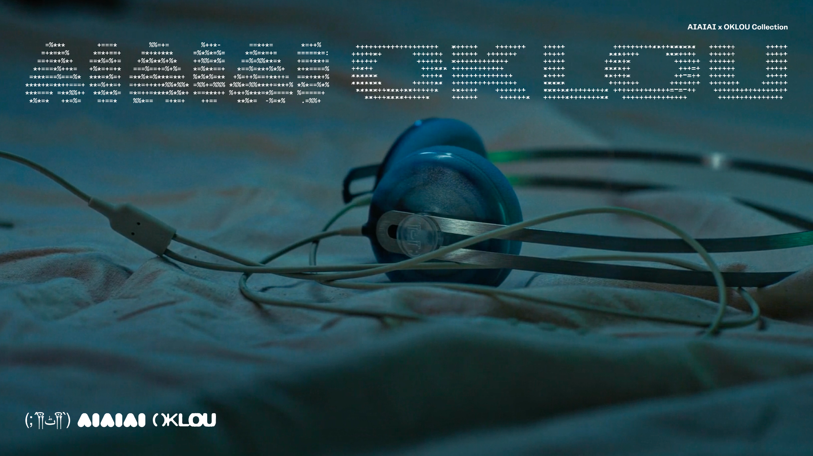
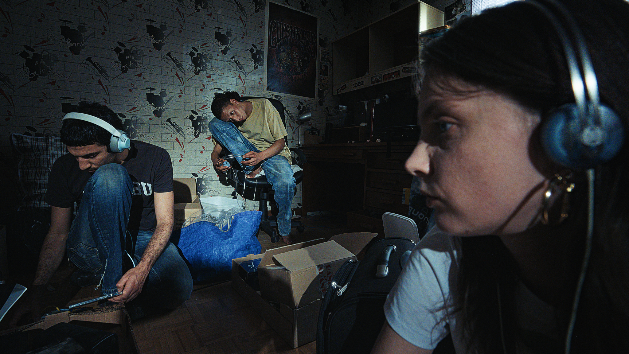
Marketing Plan
Campaign
For this collab, Oklou’s team has creative directed the campaign, telling the story of the uncanniness of everyday life.
16x still images
4x videos
Product renders
All are currently available on partner portal.
OKLOU x AIAIAI

Slide 6
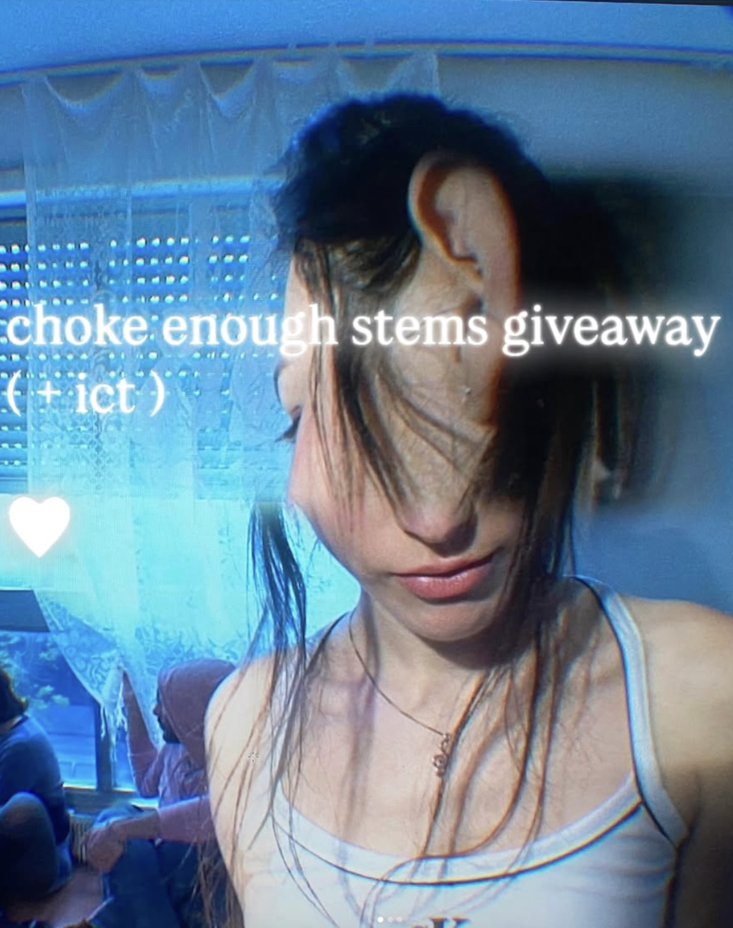
Marketing Plan
Twitch Stream + Giveaway
In order to integrate Oklou’s fanbase in an organic way, but also amplify the launch as much as possible across her communities, we will do a Twitch stream together. Oklou typically has around 60k people tune into her streams, and the recording lives on YouTube afterward.
During the stream, Oklou will give away the steams for Harvest Sky, as it’s the track that’s gaining the most traction at festivals. People will submit their remixes and the community will vote - winner will receive headphones.
Underscores will be a guest on the stream as she co-produced the track.
OKLOU x AIAIAI

Slide 7
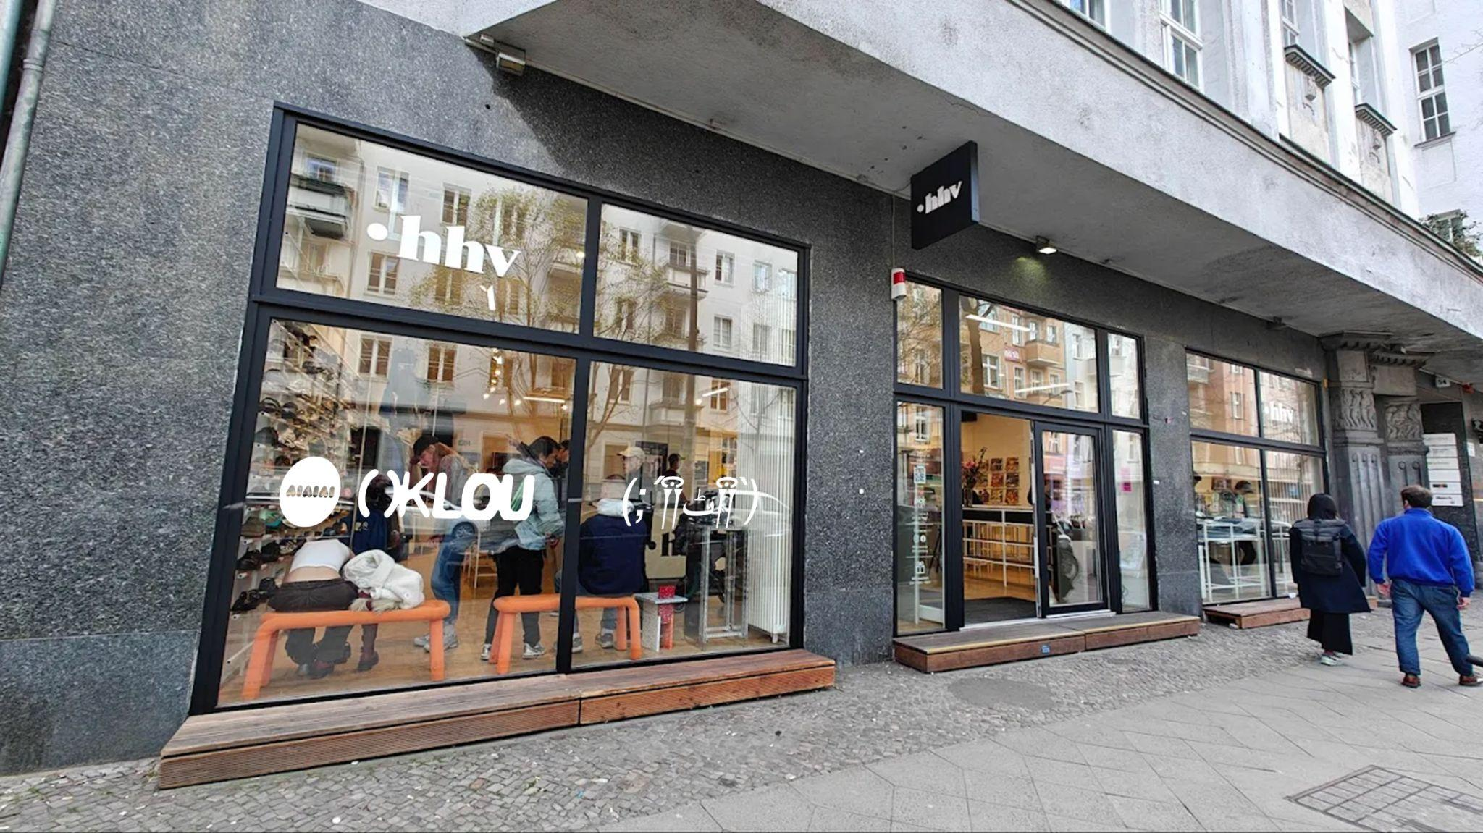


Marketing Plan
In-Store Events
We’re planning a series of record store in stores to celebrate the launch of the collab. They will take place in hot spot cities, and will feature our bespoke POS.
(TBC)
Rush Hour(Amsterdam)
Kristina Records (London)
A-one (Paris)
HHV (Berlin)
Sweat Records (Miami),
On Maritime (LA)
Finer Sounds (NYC)
OKLOU x AIAIAI

Slide 8
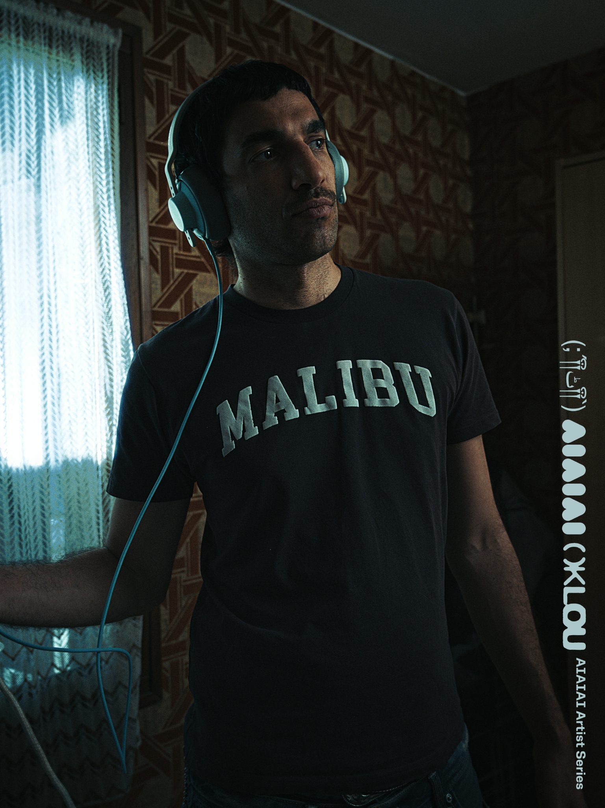
Marketing Plan
Artists & Seeding
We have created a target list of KOL together with Oklou’s team. They’re sending to a list of around 30-50 artists / friends, and we‘ve added our own contacts as well.
The goal with seeding is to spread awareness through posting to their channels, and reposting to ours.
Targets include:
Addison Rae
AG Cook
Arca
Billie Eilish
Bladee
Clairo
Danny L Harle
Lorde
Olivia Rodrigo
Pinkpantheress
Rosalía
Shygirl
Skrillex
Tame Impala
Underscores
Young Thug
Yung Lean
OKLOU x AIAIAI

