Slide 1

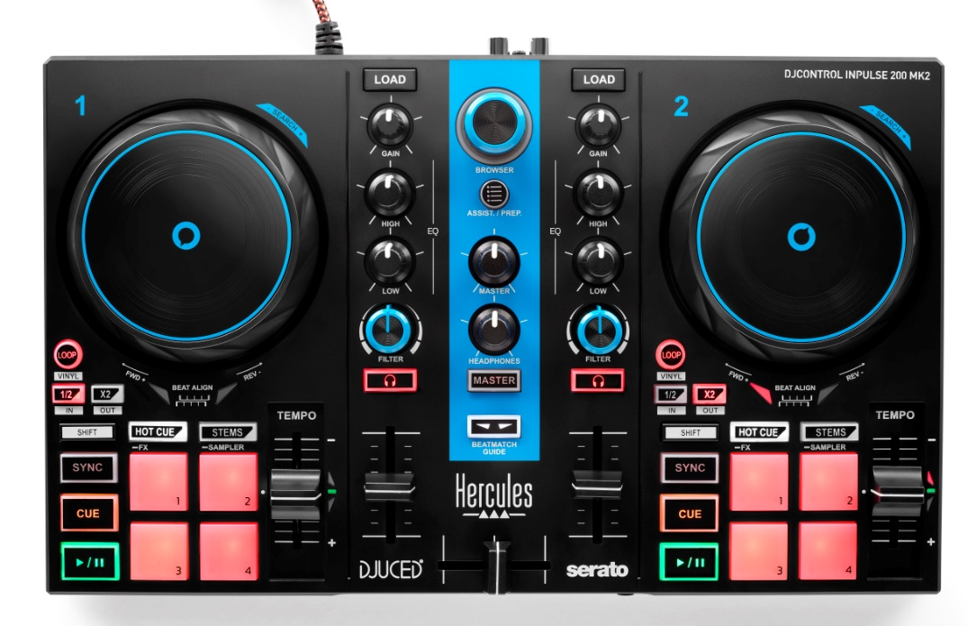


Choose the right controller to start DJing
Train your ears and learn to beatmatch manually with the built-in dynamic guide lights
Mix with Serato DJ Lite and DJUCED®
Learn from the DJ Academy tutorials
Separate tracks into stems to make mashups
Mix tracks from Beatport LINK, Beatsource LINK, SoundCloud Go+ and TIDAL+DJ extension streaming services
Mix and scratch with confidence, have fun and improve your skills!
*
KEY FEATURES
THE GOLD STANDARD FOR 2-DECK MIXING
Built-in audio: Master (speakers) and monitoring (headphones) outputs
Decks: 2 Play, Cue (+Sync, Shift) sections, 2 jog wheels, 2 x 4 pads with 4 modes (Hot Cue, Stems, FX, Sampler), 2 tempo faders, 2 Loop sections
Mixing: 1 crossfader, 2 mixers (Gain, 2-band EQ, Filter, volume), monitoring controls, master volume
STEMS
Split up tracks into instrumental and vocal stems
Create mashups by playing a different vocal over the instrumental
Create fresh transitions by mixing the instrumental of the next track over the vocal of the one that’s playing
BEATMATCH GUIDE
Built-in light guides: no need to look at a screen
Tempo guide: indicates where to move the tempo fader
Beat Align guide: indicates which direction to turn the jog wheel
mixing and performance DJ software from Hercules
Assistant: suggests the best upcoming tracks, so that you’ll always stay inspired
Stems: separate the vocal and instrumental parts of tracks to enhance your musical creations
Precise audio engine and full DJing features
  with features for learning to mix and scratch
Use stems to create separate a cappella and instrumental parts and take your mashups to the next level
Includes a free 2-week trial of Serato DJ Pro, the full-featured professional DJ software from Serato
Serato DJ Lite is based on the same technology as Serato DJ Pro
Compatible with streaming services: mix millions of tracks from Beatport LINK, Beatsource LINK, SoundCloud Go+ and TIDAL+DJ extension
DJ Academy: video tutorials from Hercules that help you learn to mix and improve your skills
Hercules Official Music: royalty-free tracks that you can mix with right away

Slide 2
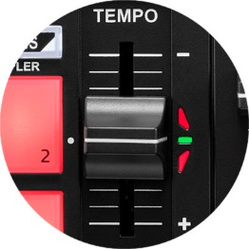
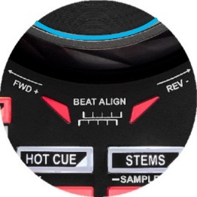
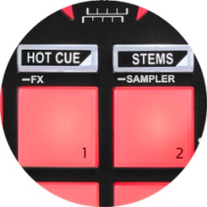
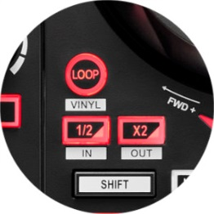



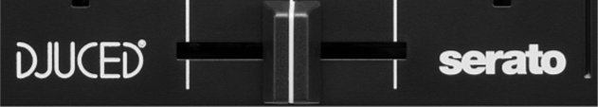

 | TECHNICAL SPECIFICATIONS
DIMENSIONS/ WEIGHT | Size: 12.6 x 7.7 x 1.9“ / 320 x 195 x 49 mm Weight: 2.0 lb / 0.9 kg
 | Jog wheel diameter: 3.5” / 90 mm
BUILT-IN AUDIO OUTPUTS | Master output for speakers: 2 RCA jacks
 | Headphones output: 1/8” / 3.5 mm stereo mini-jack
 | Audio resolution: 44.1 kHz / 24-bit
CONTROLS | Mixing controls Per deck: 1 filter knob, 2 EQ knobs, 1 gain knob, 1 volume fader General: crossfader, master volume knob, headphones volume knob
 | Controls per deck Jog wheel: touch detection for vinyl mode 4 pads x 4 modes (Hot Cue, Stems, FX, Sampler) Loop section: Loop On/Off, In/Out Play/Pause, Cue, Shift, Sync, Tempo fader
 | Browser controls Browser knob + 2 Load buttons + Assistant button
BEATMATCH GUIDE | Tempo: light guide alongside each tempo fader
 | Beat Align: light guide below each jog wheel
ASSISTANT | Assistant: DJUCED® suggests tracks from your library that match the one playing in terms of BPM, key and energy
DJ ACADEMY | Video tutorials to help you learn the basics of DJing, master the software and hone your skills https://www.hercules.com/dj-academy/
OFFICIAL MUSIC | Dozens of new royalty-free tracks that you can use to mix https://www.hercules.com/music/
SOFTWARE | DJUCED®
 | Serato DJ Lite
SYSTEM REQUIREMENTS | https://serato.com/dj/lite/downloads?systemrequirements#system-requirements
 | https://www.djuced.com/downloaddjuced/
Beatmatch Guides
Tempo
Beat Align
Stems mode on pads
Loop section
2 software applications included
BOX CONTENTS
DJControl Inpulse 200 MK2 Blue Edition
Braided USB cable attached to the controller
DJUCED® and Serato DJ Lite licenses
Instruction manual
Warranty information leaflet
PACKAGING INFORMATION
Box dimensions: 14.3 x 9.2 x 3.1” / 363 x 233 x 80 mm (W x H x D)
Master carton dimensions: 15.6 x 10.4 x 3.7” / 395 x 263 x 95 mm (W x H x D)
Units per master carton: 1
Master carton weight: 3.3 lb / 1.49 kg
Units per pallet (31.5 x 47.2” / 80 x 120 cm): 144
LOGISTICS INFORMATION
Product name | DJControl Inpulse 200 MK2 Blue Edition
Version | World | China
Product code | 4781063 | 4781084
International barcode (exclude U.S. and Canada) | 3362934747213 | 3362934747442
U.S. and Canada barcode | 663296425157 | -

