Slide 1

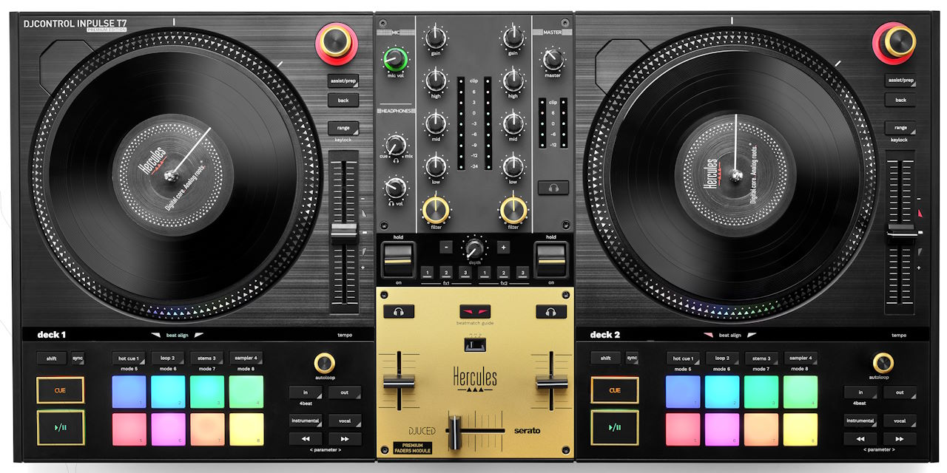



The DJ controller that helps you learn how to spin on vinyl
2 motorized platters to practice DJing on vinyl
Separate 7-inch / 17.8-cm vinyl record, felt slipmat and platter, allowing you to remove the vinyl record
Central mixer: genuine mixer layout
Perfect for use on the go: weighs just 11 lb / 5 kg, retractable feet, easy to transport
Premium: gold-colored accents, built-in premium fader module, 1 carry bag and 2 extra felt slipmats for scratching included
Included software: Serato DJ Lite and DJUCED®
THE SENSATIONS OF VINYL
THE SAME MOVES YOU’D MAKE WITH VINYL RECORDS
Follow the rotation to feel how the tempo changes
Slow down or speed up playback using the vinyl record’s label or the ring around the platter
Pause or Play by putting your fingers on the vinyl record or taking them off
SIMILAR FEEL TO VINYL TURNTABLES
Mix, beatmach or scratch on platters that go from 0 to 33⅓ RPM in 1/10 of a second
Genuine materials: vinyl record, felt slipmat, metal platter
Standard size: 7-inch / 17.8-cm vinyl record, 3.9-inch / 10-cm tempo fader
The same technology as Serato DJ Pro
Helps you learn how to mix and scratch
With stems, you can create amazing mashups combining the vocals from one track with the melody from another track
Easy to learn, yet with powerful features that will really let you impress your audiences
Full-featured software: 8 Hot Cue points, Slip mode, recording, and much more
Super-helpful mixing features: Beatmatch Guide, Assistant, Energy level
Supported streaming services for DJs: Beatport, Beatsource, TIDAL, SoundCloud

Slide 2

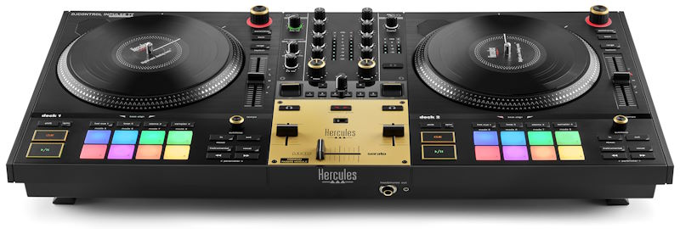
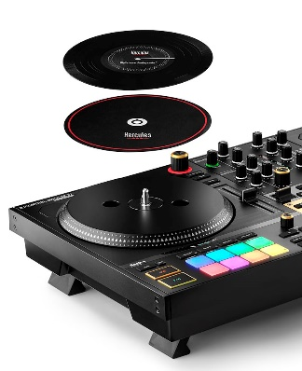
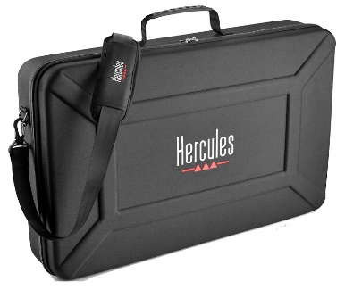
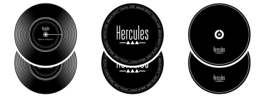



TECHNICAL SPECIFICATIONS
DIMENSIONS/ WEIGHT | Size: 25.7 x 13.8 x 3.5” / 65.2 x 35 x 9 cm (feet retracted)
 | Weight: 11 lb / 5 kg
BUILT-IN AUDIO | 2 pairs of Master outputs (speakers): 2 x XLR + 2 x RCA
 | 2 headphones outputs: ¼” / 6.35 mm stereo jack + 1/8” / 3.5 mm stereo mini-jack
 | Microphone input: ¼” / 6.35 mm jack (balanced)
 | Audio resolution: 44.1 kHz / 24-bit
MOTORIZED PLATTERS | Motorized platters: 33⅓ RPM (33⅓ RPM/45 RPM if using Serato DJ Pro) Felt slipmats and vinyl records are held in place by the central axis
CONTROLS | Mixing controls (center section) Layout similar to the setup of a mixer Effects controls
 | Controls per deck (left and right) On top, turntable-style layout: platter + tempo fader On the bottom, DJ controller-style layout: transport buttons, 8 RGB pads, controls for loops and stems
BEATMATCH GUIDE | Tempo: light guide alongside each tempo fader
 | Beat Align: light guide underneath each platter
ASSISTANT | Assistant: suggests upcoming tracks to be played from your music library
 | Energy: measures the consistency of the rhythm of audio tracks
SOFTWARE | DJUCED® and Serato DJ Lite
INCLUDED BAG | Semi-rigid carry bag (EVA) with shoulder strap
PREMIUM FADER MODULE | The crossfader and the 2 volume faders are of premium quality, with reinforced travel
SYSTEM REQUIREMENTS | Operating system: Windows® 10, 11 (64-bit) / macOS® 11 or higher
 | Recent Intel® Core™ i5 or better and compatible, 8 GB RAM or more, OpenGL 2.0 graphics
NEW SOFTWARE FEATURE: STEMS
DEFINITION | Stem = separation of a song into individual tracks, according to the type of sound 2 tracks for Vocals / Instruments Up to 4 tracks: Vocals, Melody, Bass, Drums
USE | Stems help to mix the vocals (singing) from one track with the melody from another track = creating a mashup
SOFTWARE | Serato DJ Lite 3 and DJUCED® 6 offer stems
BOX CONTENTS
Hercules DJControl Inpulse T7 Premium Edition
Semi-rigid carry bag (EVA) with shoulder strap
2 x felt slipmats (for mixing) + 2 x felt slipmats (for scratching) + 2 x 7-inch / 17.8-cm vinyl records
Braided USB cable
Power adapter + removable power cable
DJUCED® and Serato DJ Lite software
Instruction manual + warranty information leaflet
LOGISTICS INFORMATION
Name | Hercules DJControl Inpulse T7 Premium Edition
Versions | Product code | EAN barcode | UPC barcode
Worldwide (Europe/U.S.) | 4780938 | 3362934746384 | 663296424211
UK | 4780981 | 3362934746834
China | 4780984 | 3362934746865
Brazil | 4780982 | 3362934746841
Japan | 4780993 | 3362934746858
Australia/New Zealand | 4780985 | 3362934746872
Suggested retail price | $799.99 (United States) / €799.99 (Europe)
PACKAGING INFORMATION
Box dimensions: 28.8 x 18.0 x 6.0” / 73.2 x 45.7 x 15.2 cm
Units/master carton: 1

