Slide 1

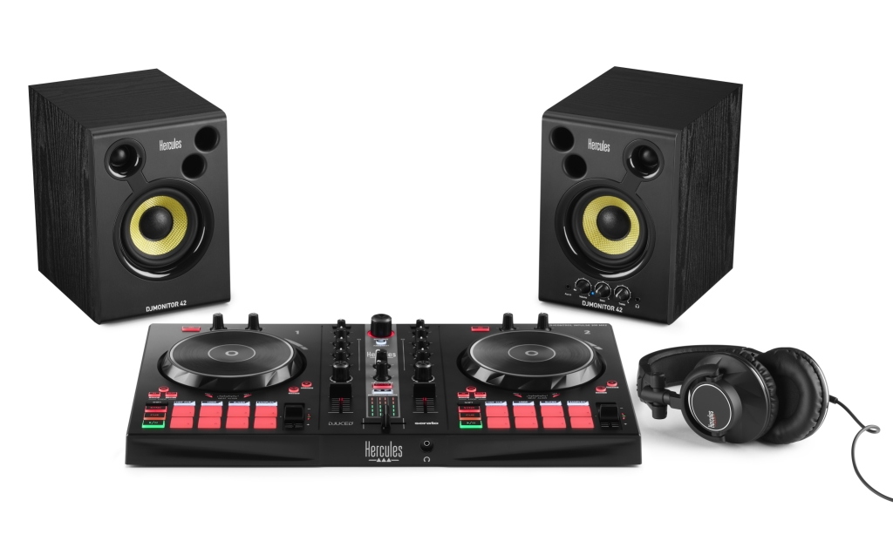







The complete kit to become a DJ
Connect the DJ controller to your computer, connect the headphones and speakers to the DJ controller, and you’re ready to mix or scratch.
Download DJUCED® and Serato® DJ Lite on PC/Mac®
Control the mix on DJControl Inpulse 300 MK2
Monitor upcoming tracks on the HDP DJ60 headphones
Listen to your mix on the DJMonitor 42 speakers
KEY FEATURES
Everything you need to become a DJ
  2-deck DJ controller with built-in audio
  Serato® DJ Lite and DJUCED® software for Windows®/macOS®
  Active speakers (2 x 20 watts RMS) for mixing at home
  DJ headphones to monitor upcoming tracks
Nothing else to add
  No need for extra cables: USB and audio cables are right there in the box
  Tutorials at https://www.hercules.com/dj-academy/
  Royalty-free music at https://www.hercules.com/music/
Designed to help you progress as a DJ
Video tutorials help you improve your skills
The Beatmatch Guide helps you sync up tracks manually
Complete controls (8 pads per deck, 3-band EQ) let you use the same DJing techniques as on a professional DJ controller
Perfect for use on the go
Easy to transport: compact, lightweight DJ kit
Quick to set up: simple software installation, and just 4 cables to connect (USB, speakers, power supply and headphones)

Slide 2


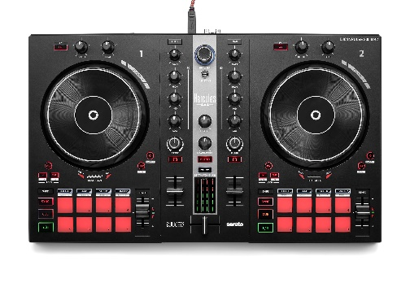
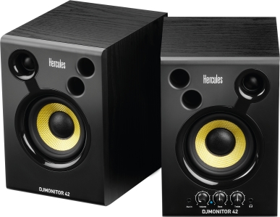
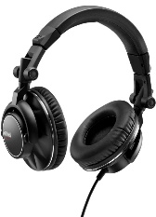


TECHNICAL SPECIFICATIONS | SPÉCIFICATIONS TECHNIQUES
DIMENSIONS | DJControl Inpulse 300 MK2 18.9 x 11.3 x 2.0” / 480 x 286 x 52 mm
 | DJMonitor 42 8.7 x 7.3 x 6.1” / 220 x 185 x 155 mm (per speaker)
WEIGHT | DJControl Inpulse 300 MK2 4.0 lb / 1.8 kg
 | DJMonitor 42 Right: 5.3 lb / 2.4 kg; Left: 4.9 lb / 2.2 kg
 | HDP DJ60 0.7 lb / 0.3 kg
SPEAKERS | 2-way active speakers 2 x 20 watts RMS Diameter Ø of drivers Woofer: 4.0” / 10.2 cm; Tweeter: 1.0” / 2.5 cm
AUDIO CONNECTIONS | DJControl Inpulse 300 MK2 Master output (speakers): 2 x RCA Headphones output: 3.5 mm jack
 | DJMonitor 42 2 RCA inputs (5.9 ft / 1.8 m RCA cable) AUX input: 3.5 mm jack Headphones output: 3.5 mm jack
 | HDP DJ60 3.5 mm jack; 8.9 ft / 2.7 m cable
CONTROLS | Mixing area controls Per deck: filter knob, 3 EQ knobs, gain knob, volume fader, VU meter General: crossfader, master volume knob, headphones volume knob, master VU meter
 | Other controls per deck Touch-detecting jog wheel 8 pads x 8 modes (Hot-Cue, Loop, Stems, Sampler) Buttons: Loop, Loop x2 & /2, Tempo Range, Slip/Vinyl FX: 1 FX button + 2 knobs (Level & Dry/Wet)
SYSTEM REQUIREMENTS | https://serato.com/dj/lite/downloads?systemrequirements#system-requirements https://www.djuced.com/downloaddjuced
Use Serato stems to split music tracks into a cappella and instrumental parts, and create great mashups on the fly
Serato® DJ Lite includes all the features you need to learn to mix and scratch
Serato® DJ Lite uses the same technology as Serato® DJ Pro
Mix music from streaming services: Beatport, Beatsource, SoundCloud Go+ and TIDAL (DJ subscription required)
Hercules DJ software for mixing and performing, including a wide range of useful features for DJing
Intelligent Music Assistant (IMA): suggests the best upcoming tracks from your music library, to help you stay inspired
Stems: splits your tracks into vocal and instrumental parts, for mixing and mashups
Mix music from streaming services: Beatport, Beatsource, SoundCloud Go+ and TIDAL (DJ subscription required)
BOX CONTENTS
DJControl Inpulse 300 MK2 + USB cable
DJMonitor 42 + power cable + audio cable
HDP DJ60 + jack adapter (3.5 mm -> 6.35 mm)
DJ controller unlocks DJUCED® and Serato® DJ Lite licenses
User manual and warranty information for each product
LOGISTICS INFORMATION
Product name | Hercules DJ Essentials Kit
Version | EU | US |  | UK
Reference | 4781049 | 4769270 |  | 4768229
EAN barcode | 3362934747053 | 3362934747060 |  | 3362934747077
U.S. barcode |  | 663296425058
Version | AU | CN |  | JP
Reference | 4781050 | 4780971 |  | 4781051
EAN barcode | 3362934747084 | 3362934746735 |  | 3362934747091
SRP | USD $399.99 / €369.99
PACKAGING INFORMATION
Box dimensions 21.2 x 13.5 x 14.8” (W x H x D) 53.8 x 34.4 x 37.7 cm
Master carton 21.7 x 15.4 x 14.2“ 55 x 39 x 36 cm
Units per master carton 1
Weight per unit in master carton 23.1 lb / 10.5 kg

